Slide 1
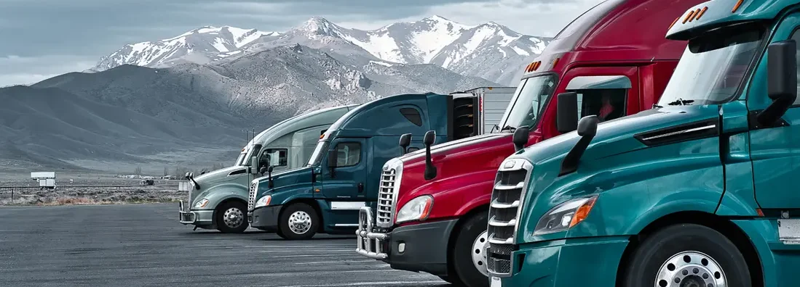
Analysis on Truck Fleet Data Big Data

Slide 2

Problem Statement
Our main responsibility as the fleet manager of AZ National Trucking (ANT) is to keep risks down and make sure that driving recklessly doesn't violate any laws.
Business objectives:
Geographical Analysis: To evaluate the relative risk levels of California's riskiest cities by comparing them to other cities to determine their relative risk levels.
Truck Model Analysis: To evaluate and compare truck models using factors such as average risk factor and count of events.
Driving Incident Analysis: To evaluate factors related to driving events.

Slide 3
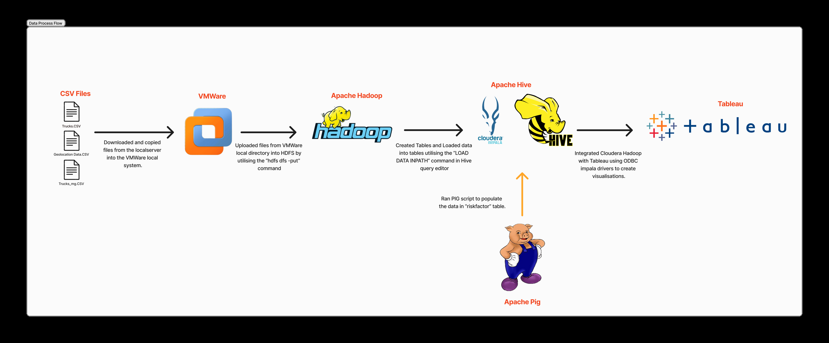
Workflow

Slide 4
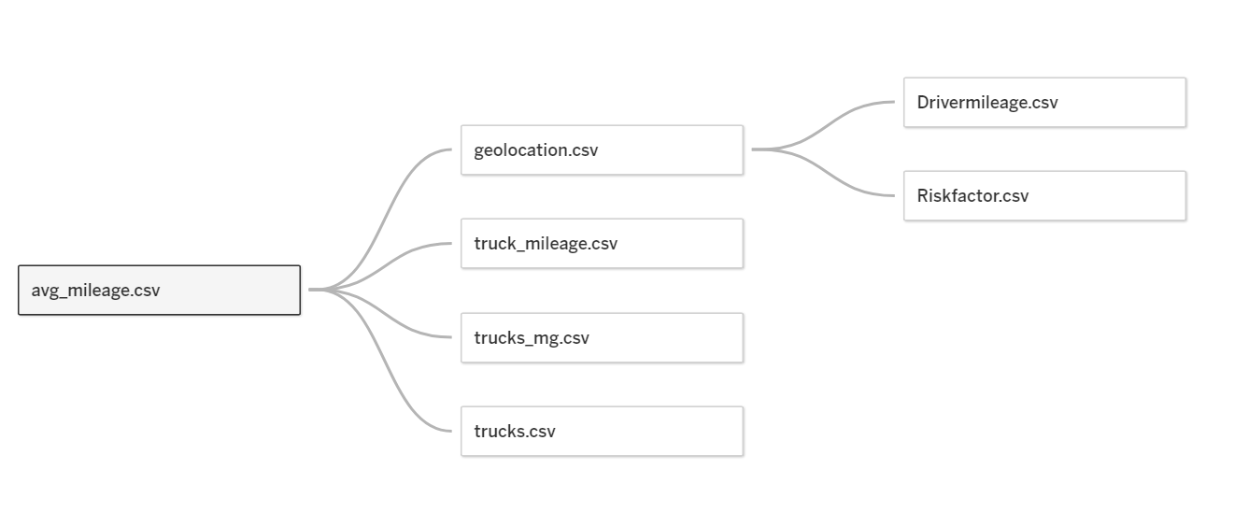
About the Data
Important Columns for modelling
Driver_Average_mileage
Total Miles
Number of Events
Risk Factor
Scaled Risk Factor using min max approach

Slide 5
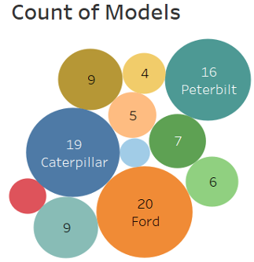
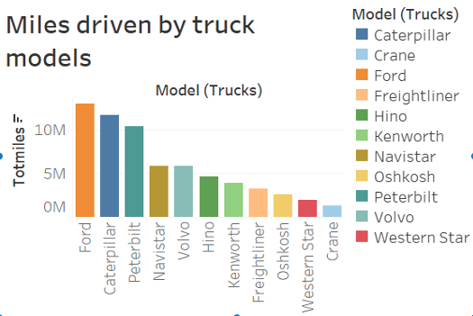
TRUCK MODEL ANALYSIS
Count of Models: This bubble chart shows the distribution of various truck models within the fleet. Each bubble represents a different truck model with its size corresponding to the count of trucks of that model.
Miles Driven by Truck Models: This bar chart depicts the total miles driven by each truck model. It provides insights into how much each model is being used, which can be important for maintenance schedules and lifecycle management.

Slide 6
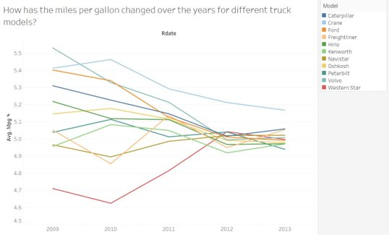
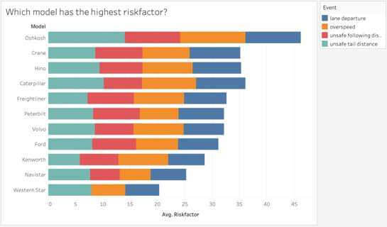
TRUCK MODEL ANALYSIS
Fuel Efficiency The graph show the fuel efficiency changes from 2009 to 2013. Most Truck models had similar fuel efficiency after 3 years of operation.
Risk Factor by Model: This bar chart ranks the truck models by a "Risk Factor" score, which likely assesses the safety or incident rate associated with each model.

Slide 7
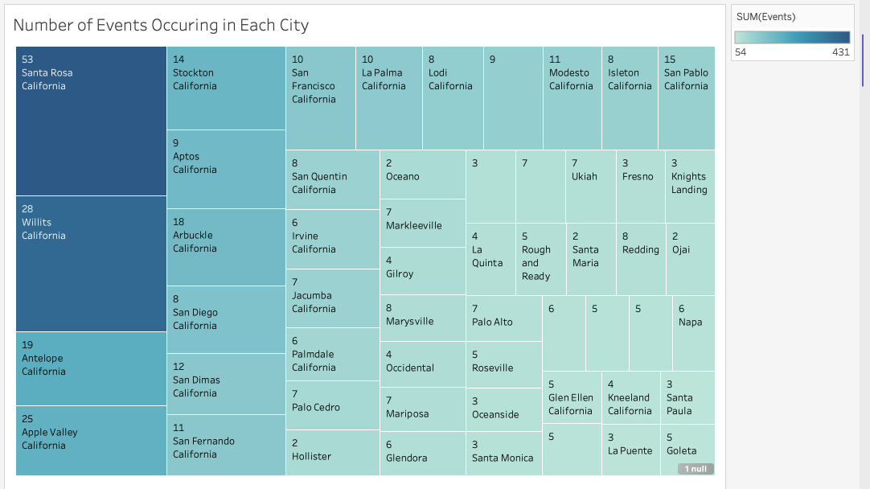
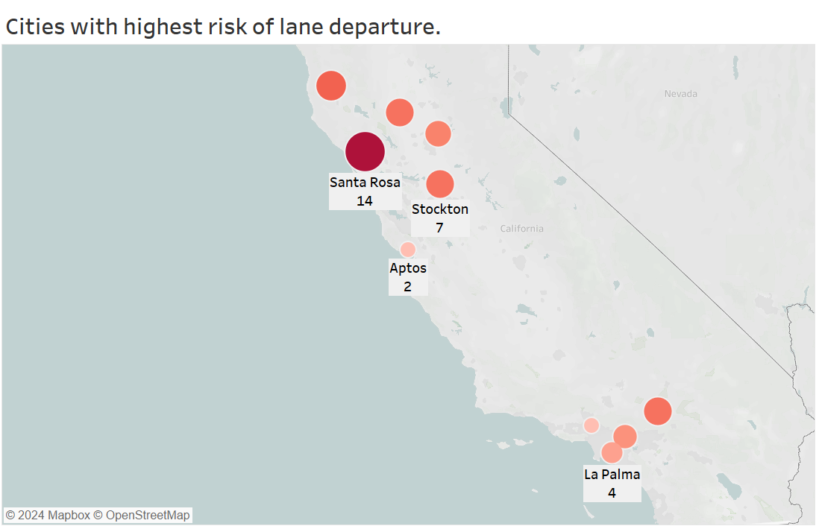
GEOGRAPHICAL ANALYSIS
Chart - Common Driving Events: This chart ranks the cities based on the frequency of all four different types of driving incidents.
Geographical Map - Lane Departure Incidents: The map highlights the distribution of lane departure incidents across various cities. The size of the circle represents the number of incidents, with larger circles indicating more incidents.

Slide 8
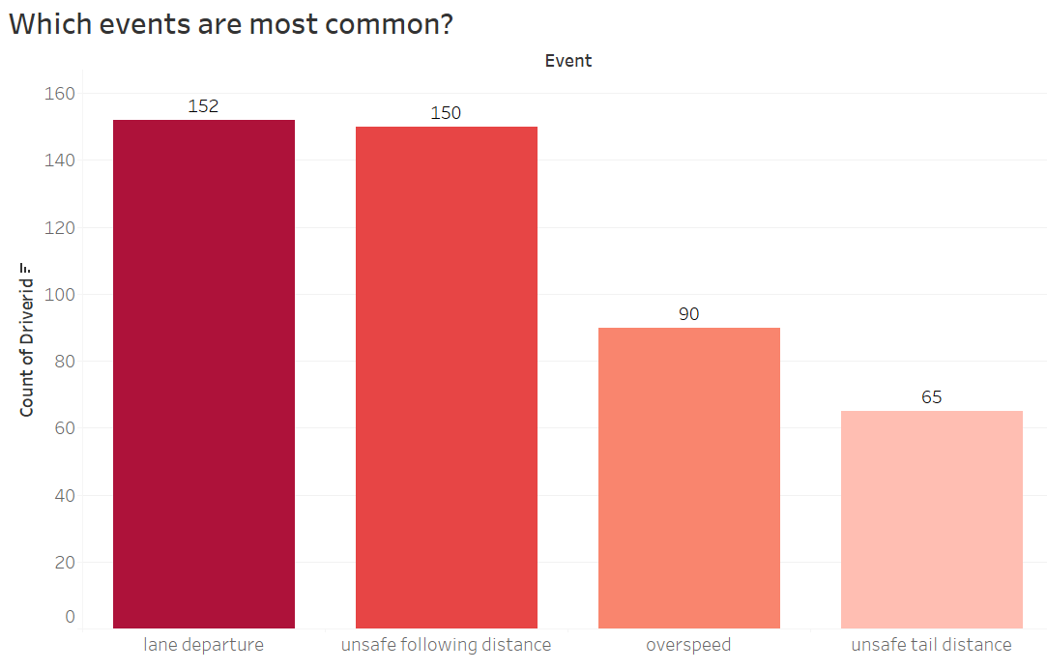
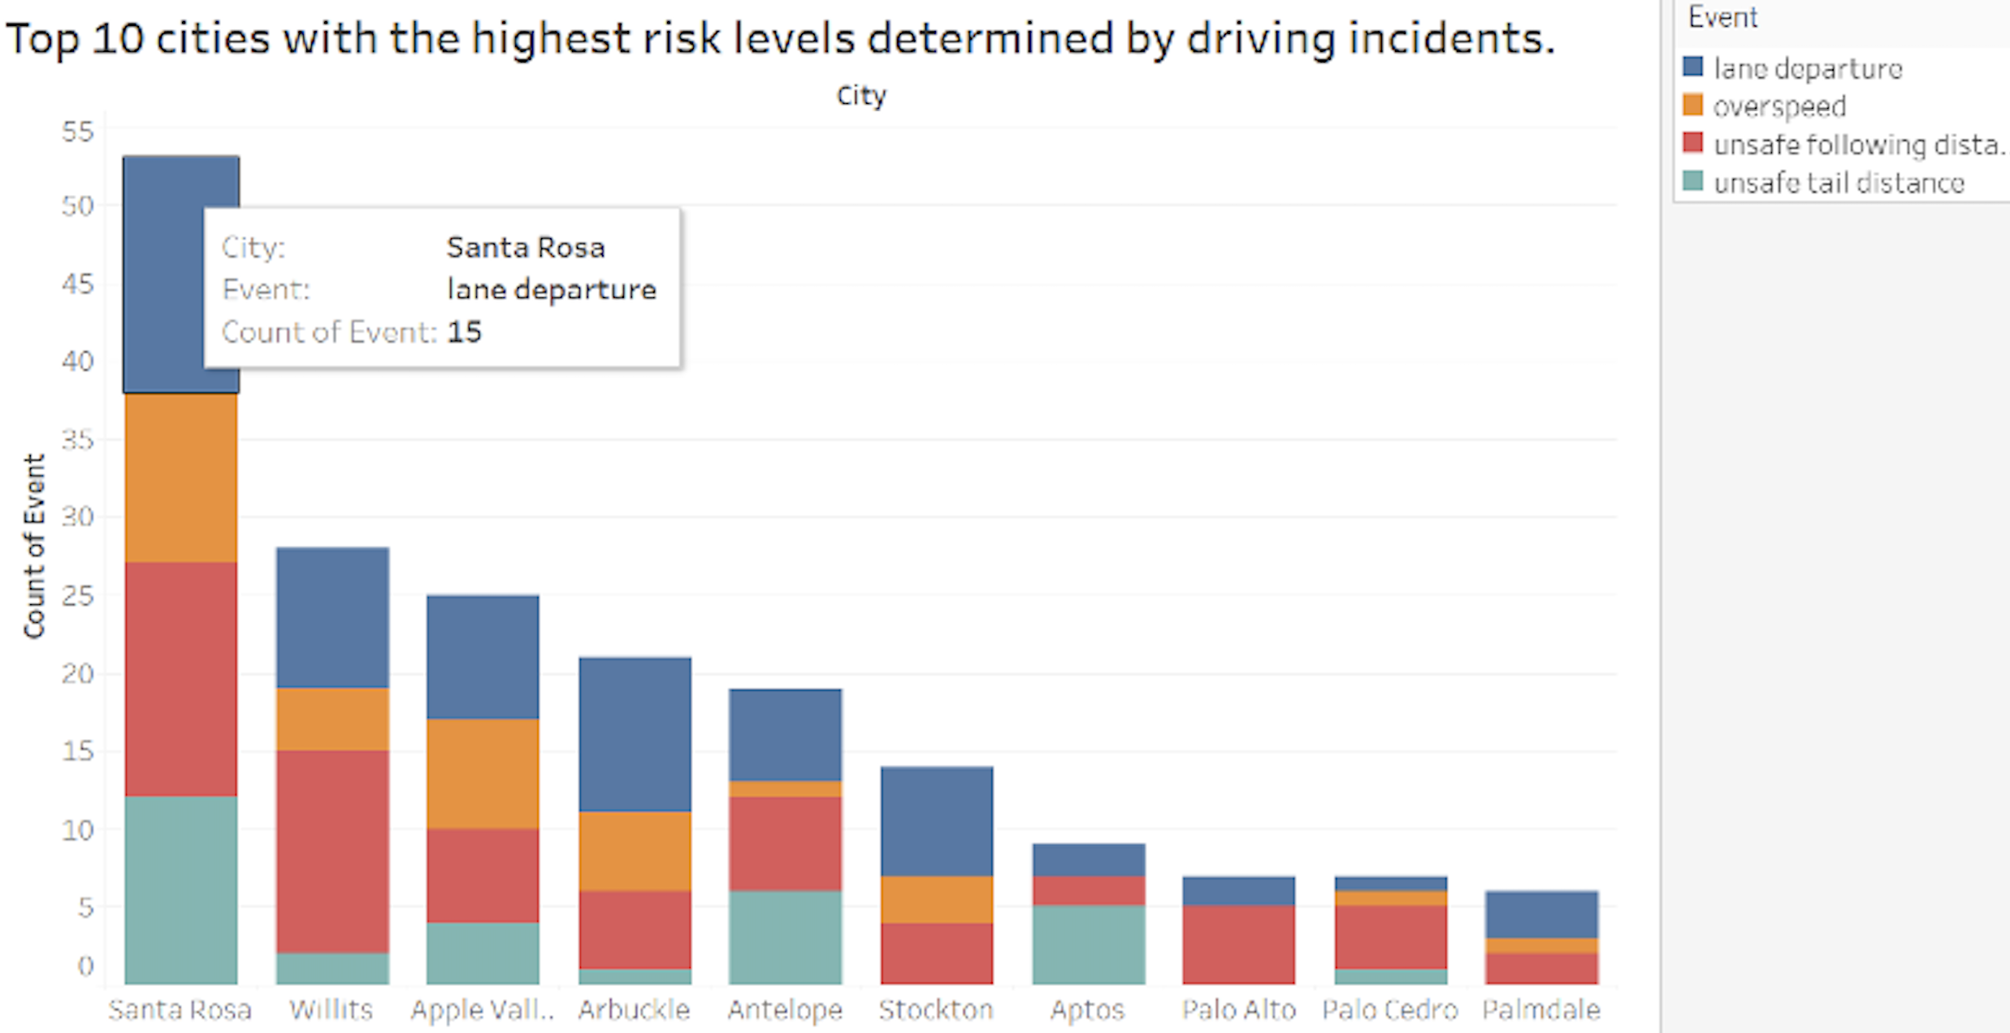
DRIVING INCIDENT ANALYSIS
Occurrences of Different Events: This graph provides a clear comparison of the frequency of four types of driving-related events recorded in the truck fleet data. ​
Top 10 Risky Cities: This bar chart ranks ten cities based on the "Count of Risk Factor", which is a metric derived from the sum of individual risk factors associated with events in each city.

Slide 9
Conclusion
Lane departure and unsafe following distance are major violations which should be investigated by the company, and they should work on improving that.
Drivers should be given feedbacks based on their violations.
Northwestern California is a bit prone to accidents and drivers should be careful when driving there.
Oshkosh truck models have the highest risk factor, and the company should investigate reducing the fleet of Oshkosh trucks.
Considering varying geo-traffic conditions, it may be prudent to assign more experienced drivers to navigate unsafe routes.

Slide 10
THANK YOU !!

